Slide 1
MOBILE REVIEW SENTIMENT IN-DEPTH ANALYSIS
S. Godfrey Winster
Ayushi Gupta
Ishit Arhatia
Divyansh Gautam
Ria Verma
HTTPS://PECTEAM.CO.IN/
1

Slide 2
1. INDEX:
TOPIC | SLIDE NUMBER
OBJECTIVE | 3
INTRODUCTION | 4
LITERATURE REVIEW | 5
RESEARCH GAPS | 6
PROPOSED METHODOLOGY | 7
RESULTS AND DISCUSSION | 8
COMPARATIVE ANALYSIS | 9
CONCLUSION AND FUTURE WORK | 10
REFERENCES | 11
https://pecteam.co.in/
2

Slide 3
2. OBJECTIVES:
Conduct sentiment analysis on a dataset comprising reviews of mobile phones to determine overall sentiment (positive, neutral, or negative).
To determine the polarity scores of different mobile brands (ie Samsung, BLU, Apple) wrt to their rating.
https://pecteam.co.in/
3

Slide 4
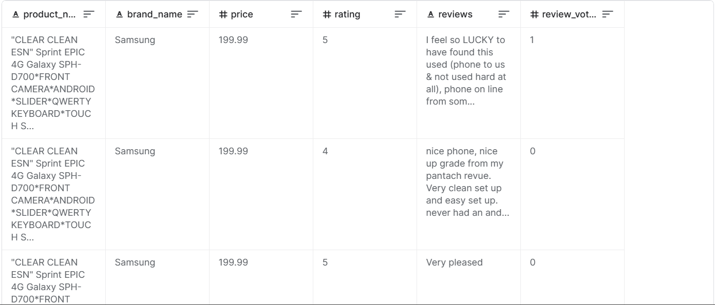
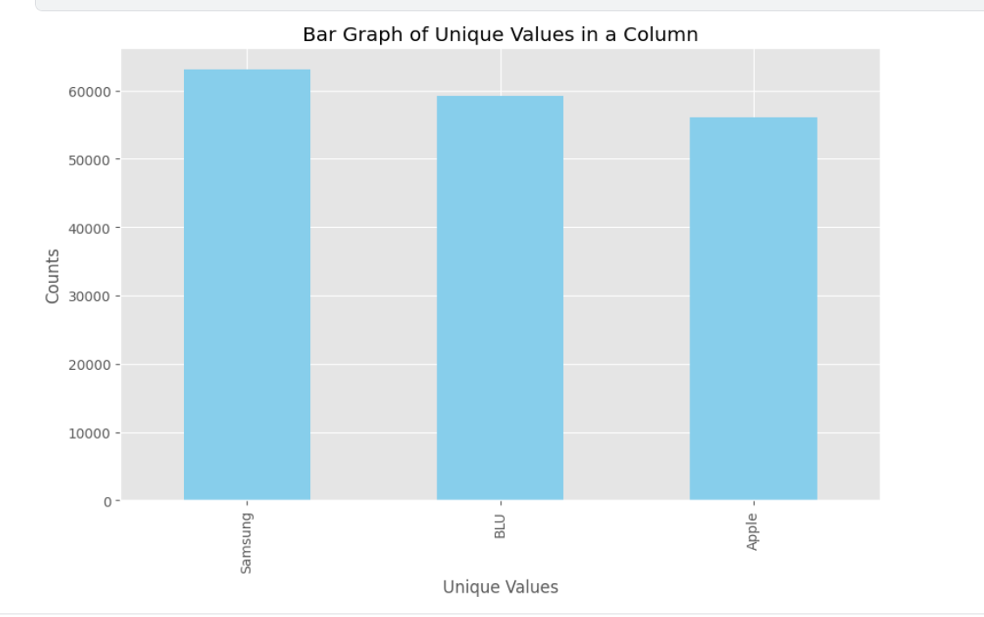
3. INTRODUCTION:
Implementation of Sentiment Analysis on Amazon reviews, leveraging natural language processing techniques.
Dataset sourced from Kaggle.
Two distinct models: VADER and roBERTA.
Aim to unravel valuable insights into customer sentiment towards mobile phones on Amazon.
https://pecteam.co.in/
4

Slide 5
4. LITERATURE REVIEW :
Paper Title | Authors | Conference/Journal | Year
Sentiment Analysis using Improved Vader and Dependency Parsing | S. Rani and P. Kumar | Computer, vol. 50, no. 5, pp. 36-43, May 2017 | 2017
Sentiment Analysis in TripAdvisor | A. Valdivia, M. V. Luzón and F. Herrera | IEEE Intelligent Systems, vol. 32, no. 4, pp. 72-77, 2017 | 2017
Text sentiment analysis using frequency-based vigorous features | A. Razzaq et al. | China Communications, vol. 16, no. 12, pp. 145-153, Dec. 2019 | 2019
Sentiment Analysis for E-Commerce Product Reviews in Chinese Based on Sentiment Lexicon and Deep Learning | L. Yang, Y. Li, J. Wang and R. S. Sherratt | IEEE Access, vol. 8, pp. 23522-23530, 2020 | 2020
Real-Time Twitter Sentiment Analytics and Visualization Using Vader | A. R. Pai, M. Prince and C. V. Prasannakumar | 2022 2nd International Conference on Intelligent Technologies (CONIT) | 2022
NER in Hindi Language Using Transformer Model: XLM-Roberta | A. A. Choure, R. B. Adhao and V. K. Pachghare | 2022 IEEE International Conference on Blockchain and Distributed Systems Security (ICBDS) | 2022
Identifying Security and Privacy Violation Rules in Trigger-Action IoT Platforms With NLP Models | B. Breve, G. Cimino and V. Deufemia | IEEE Internet of Things Journal, vol. 10, no. 6, pp. 5607-5622, 15 March 15, 2023 | 2023
A Survey of Text Representation and Embedding Techniques in NLP | R. Patil, S. Boit, V. Gudivada and J. Nandigam | IEEE Access, vol. 11, pp. 36120-36146, 2023 | 2023
https://pecteam.co.in/
5

Slide 6
5. RESEARCH GAPS :
Analysis based on Brand Name.
Comparative study
https://pecteam.co.in/
6

Slide 7
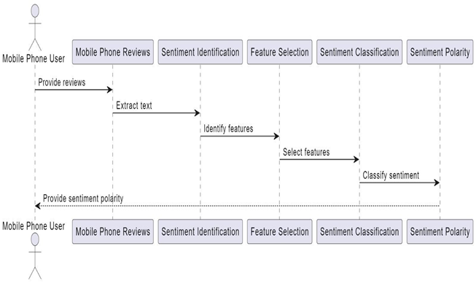
6. PROPOSED METHODOLOGY :
https://pecteam.co.in/
7

Slide 8
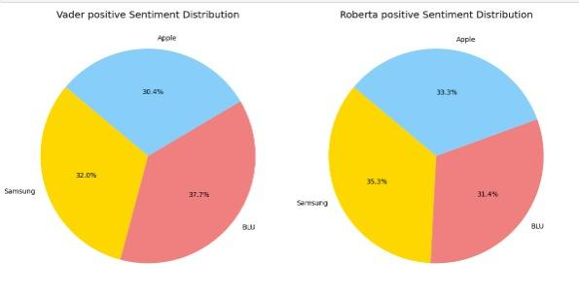
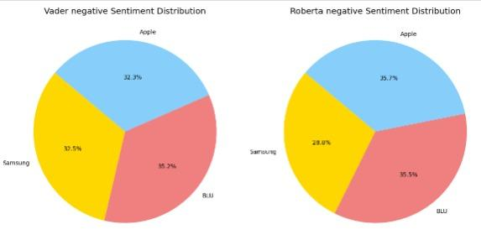
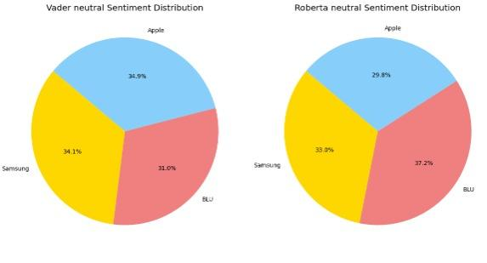
7. RESULTS & DISCUSSION:
https://pecteam.co.in/
8

Slide 9
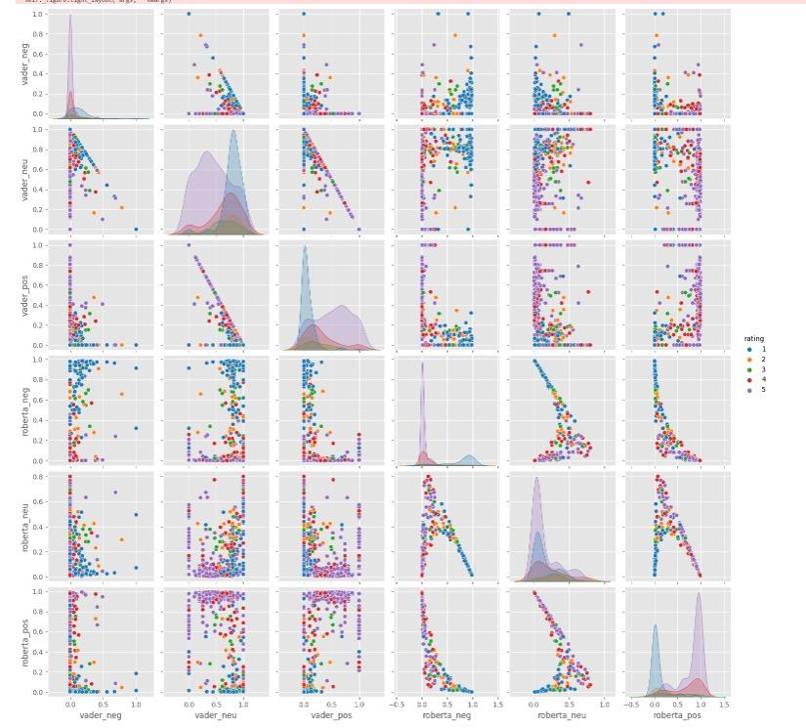
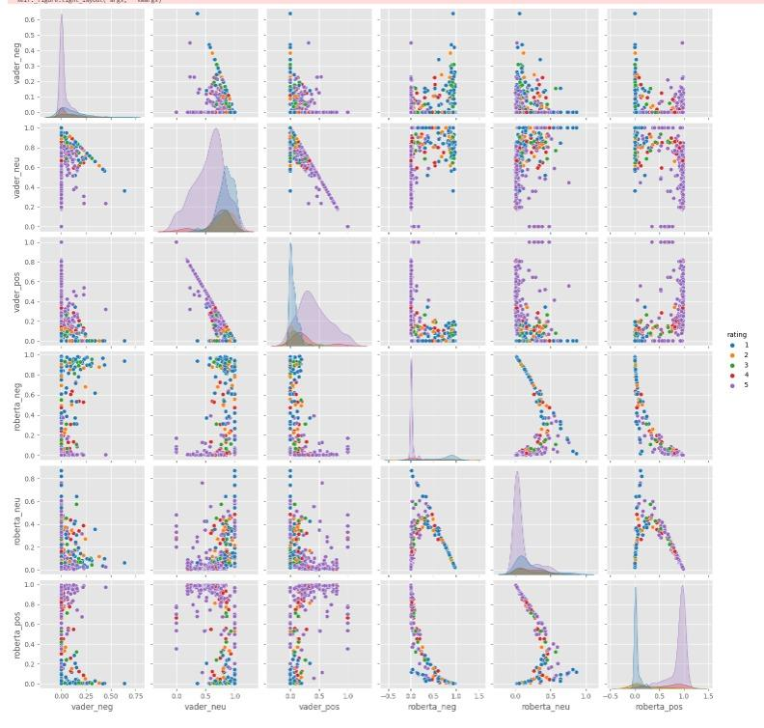
8. COMPARATIVE ANALYSIS:
https://pecteam.co.in/
9

Slide 10
9. CONCLUSION & FUTURE WORK :
BLU Brand had the highest positive vader sentiment distribution whereas Samsung had the highest positive roBERTa sentiment distribution.
BLU also had the highest negative Vader and roBERTa sentiment distribution.
Future directions include
cross-linguistic sentiment analysis, emotion detection, and addressing ethical concerns.
Real-time sentiment analysis tools.
Broader model application on larger datasets to provide more comprehensive sentiment insights.
https://pecteam.co.in/
10

Slide 11
10. REFERENCES :
1. S. Rani and P. Kumar, "A Sentiment Analysis System to Improve Teaching and Learning," Computer, vol. 50, no. 5, pp. 36-43, May 2017.
2. A. Valdivia, M. V. Luzón and F. Herrera, "Sentiment Analysis in TripAdvisor," IEEE Intelligent Systems, vol. 32, no. 4, pp. 72-77, 2017.
3. M. Ebrahimi, A. H. Yazdavar and A. Sheth, "Challenges of Sentiment Analysis for Dynamic Events," IEEE Intelligent Systems, vol. 32, no. 5, pp. 70-75, September/October 2017.
4. A. Razzaq et al., "Text sentiment analysis using frequency-based vigorous features," China Communications, vol. 16, no. 12, pp. 145-153, Dec. 2019.
5. L. Yang, Y. Li, J. Wang and R. S. Sherratt, "Sentiment Analysis for E-Commerce Product Reviews in Chinese Based on Sentiment Lexicon and Deep Learning," IEEE Access, vol. 8, pp. 23522-23530, 2020.
6. G. Veena, A. Vinayak and A. J. Nair, "Sentiment Analysis using Improved Vader and Dependency Parsing," in 2021 2nd Global Conference for Advancement in Technology (GCAT), Bangalore, India, 2021, pp. 1-6.
7. A. R. Pai, M. Prince and C. V. Prasannakumar, "Real-Time Twitter Sentiment Analytics and Visualization Using Vader," in 2022 2nd International Conference on Intelligent Technologies (CONIT), Hubli, India, 2022, pp. 1-4.
8. A. A. Choure, R. B. Adhao and V. K. Pachghare, "NER in Hindi Language Using Transformer Model: XLM-Roberta," in 2022 IEEE International Conference on Blockchain and Distributed Systems Security (ICBDS), Pune, India, 2022, pp. 1-5.
9. B. Breve, G. Cimino and V. Deufemia, "Identifying Security and Privacy Violation Rules in Trigger-Action IoT Platforms With NLP Models," in IEEE Internet of Things Journal, vol. 10, no. 6, pp. 5607-5622, 15 March 15, 2023.
10. R. Patil, S. Boit, V. Gudivada and J. Nandigam, "A Survey of Text Representation and Embedding Techniques in NLP," in IEEE Access, vol. 11, pp. 36120-36146, 2023.
https://pecteam.co.in/
11

